Slide 1
Copilot Features
Notes:
Let’s take a look at some of the standard copilot features

Slide 2
GitHub Copilot / Code Completion
Save time and energy on writing code.
Convert comments to code
Autosuggest tests
Show alternatives
Notes:
Within the editor of the IDE, GitHub Copilot uses the context of the code and synthesizes code to match as developers write
Convert comments to code: describe the logic you want, and let GitHub Copilot assemble the code for you
Autofill for repetitive code: quickly produces boilerplate and fills in repetitive code patterns
Show alternatives: show a list of solutions to use as provided, or edit to meet your needs

Slide 3

GitHub Copilot / Chat
Improve code quality with contextual conversations.
Context specific coding support
Explains concepts and specific code blocks
Debugging and vulnerability remediation assistance
Notes:
Developers can also chat with GitHub Copilot for context-specific coding support. Copilot is able to explain concepts and specific code blocks as well as assist with debugging, all in an approachable conversational manner.

Slide 4
GitHub Copilot / CLI
Enable developers to take command of the CLI.
Git command assistance in the terminal
Command and script explanations
Notes:
GitHub Copilot is able to provide assistance right in the terminal. Need help with multi-step shell commands and scripting? Just explain what you want to do and Copilot is there to help.

Slide 5
GitHub Copilot / Chat
Chat assistance integrated into GitHub.com.
COPILOT ENTERPRISE
Personalized responses based on your organization’s codebase
Accelerate onboarding into new repositories, projects, files, issues, and more
Chat with knowledge of the open source community
Notes:
Index specific repos within you organization
With Copilot Chat connected to your repositories on GithHb.com, Copilot Enterprise allows your teams of developers to quickly get up to speed on your codebase, search through and build documentation, get suggestions based on internal and private code, and quickly review pull requests. Additionally, smart actions, such as the ability to generate pull request summaries, will be available throughout GitHub helping developers stay in their flow state with the click of a button. And of course, this all comes with enterprise-grade security, safety and privacy.

Slide 6

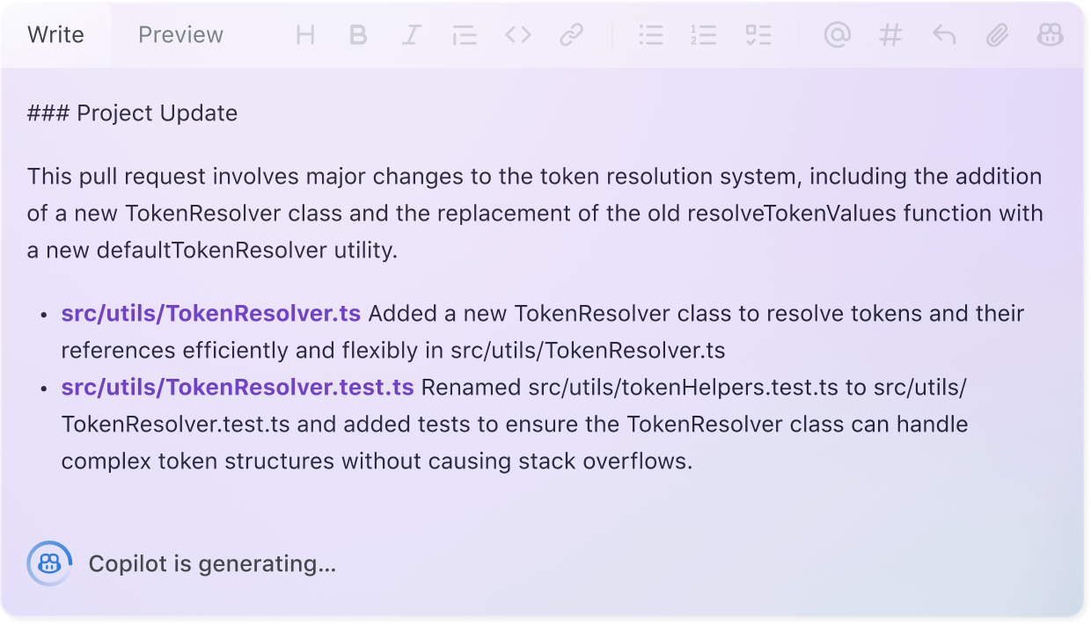


Pull request summaries
Pull requests that tell at story
GitHub Copilot keeps track of your work, suggests descriptions, and helps reviewers reason about your changes.
Notes:
Both as a developer and a reviewer

Slide 7

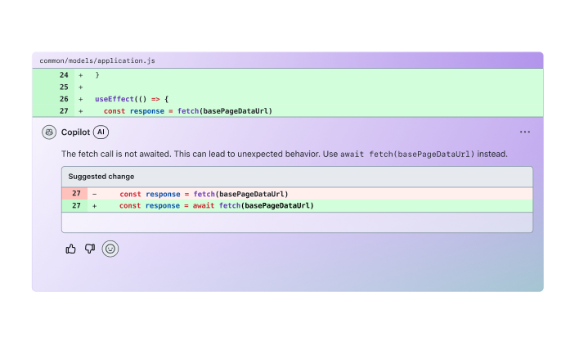
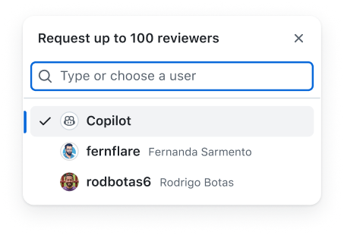
Code review
Feedback without the wait
Iterate faster and get “ready to merge” instantly. Copilot spots bugs, fixes typos, improves error handling, and more— all while you wait for a human review
https://github.blog/changelog/2025-02-26-code-review-in-github-copilot-is-now-in-public-preview
Notes:
Take that one step further, we can now ask that copilot be a reviewer

Slide 8

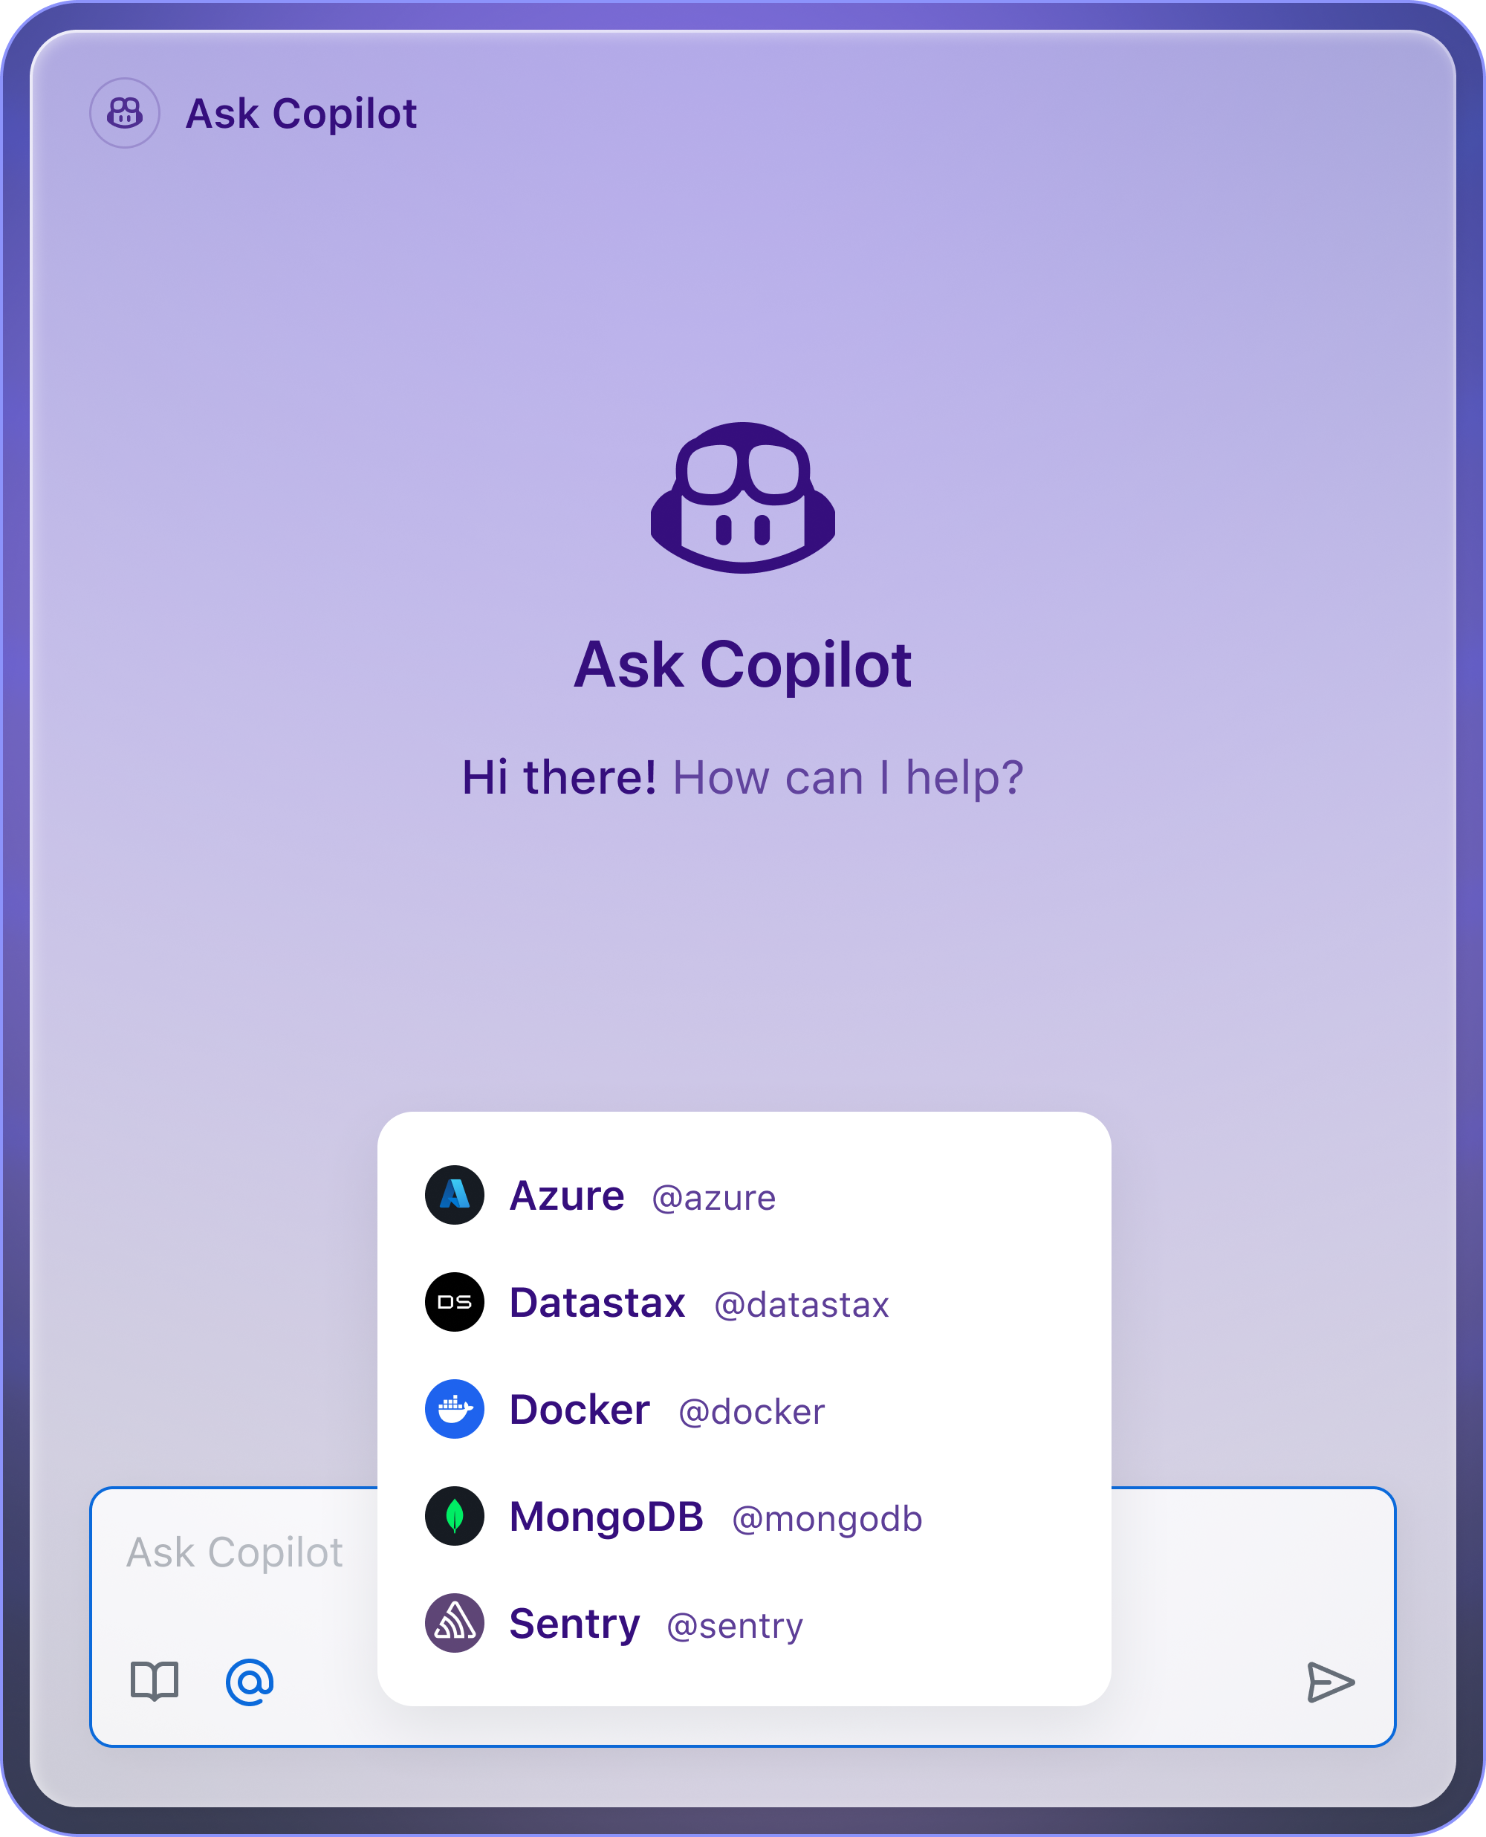
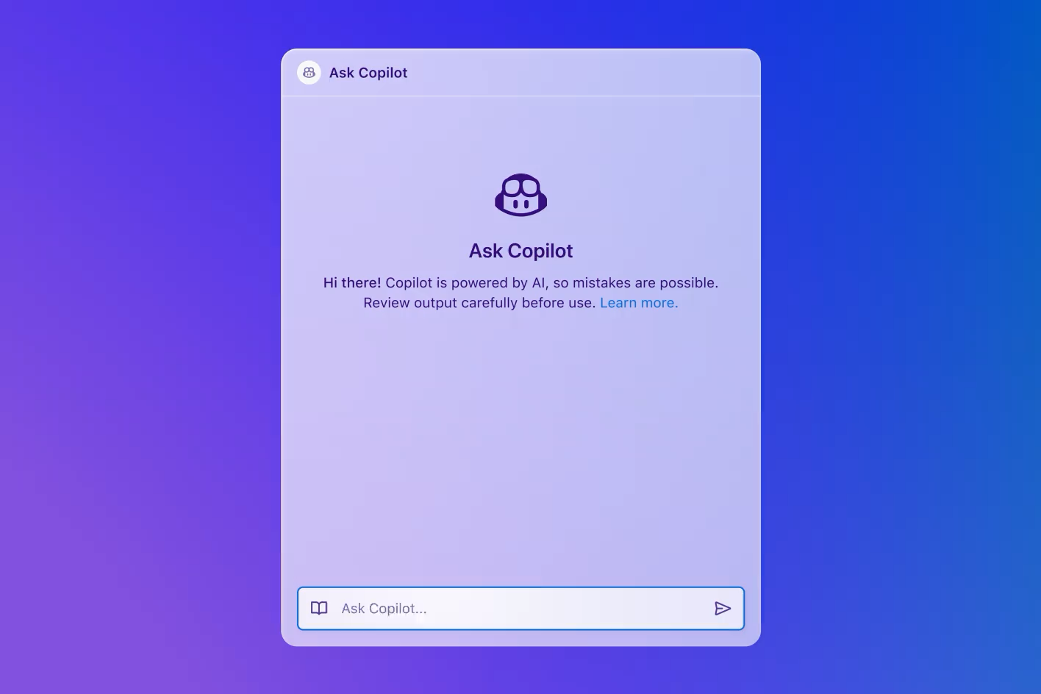
Copilot Extensions
Third-party agents for everyday tasks
Enhance GitHub Copilot with ready-to-use extensions or build your own using our developer platform with APIs, documentation, and guides.
Notes:
Can now use and build custom extensions

Slide 9

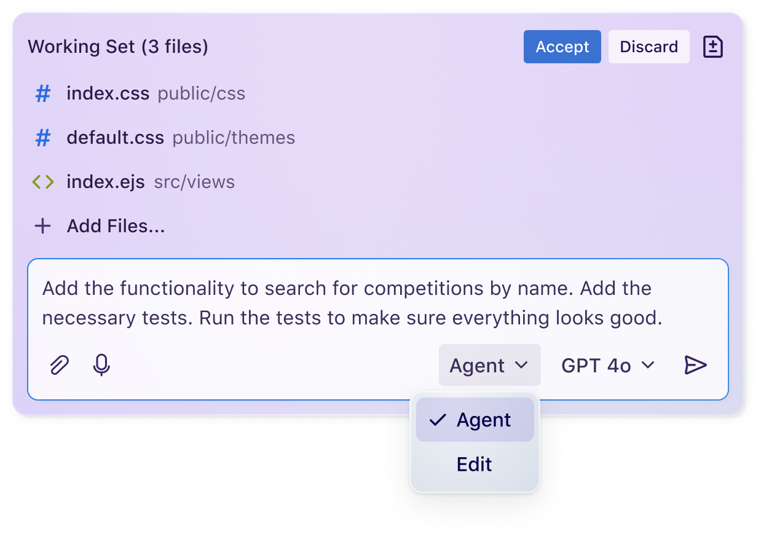
Agent mode
Iterate securely, automatically. Here, there, and everywhere
Intent detection
Self-healing capabilities
Auto-resolve runtime errors
Notes:
Through Agent Mode, Copilot can now iterate on it’s own output and infer additional tasks required to complete your prompt.

Slide 10

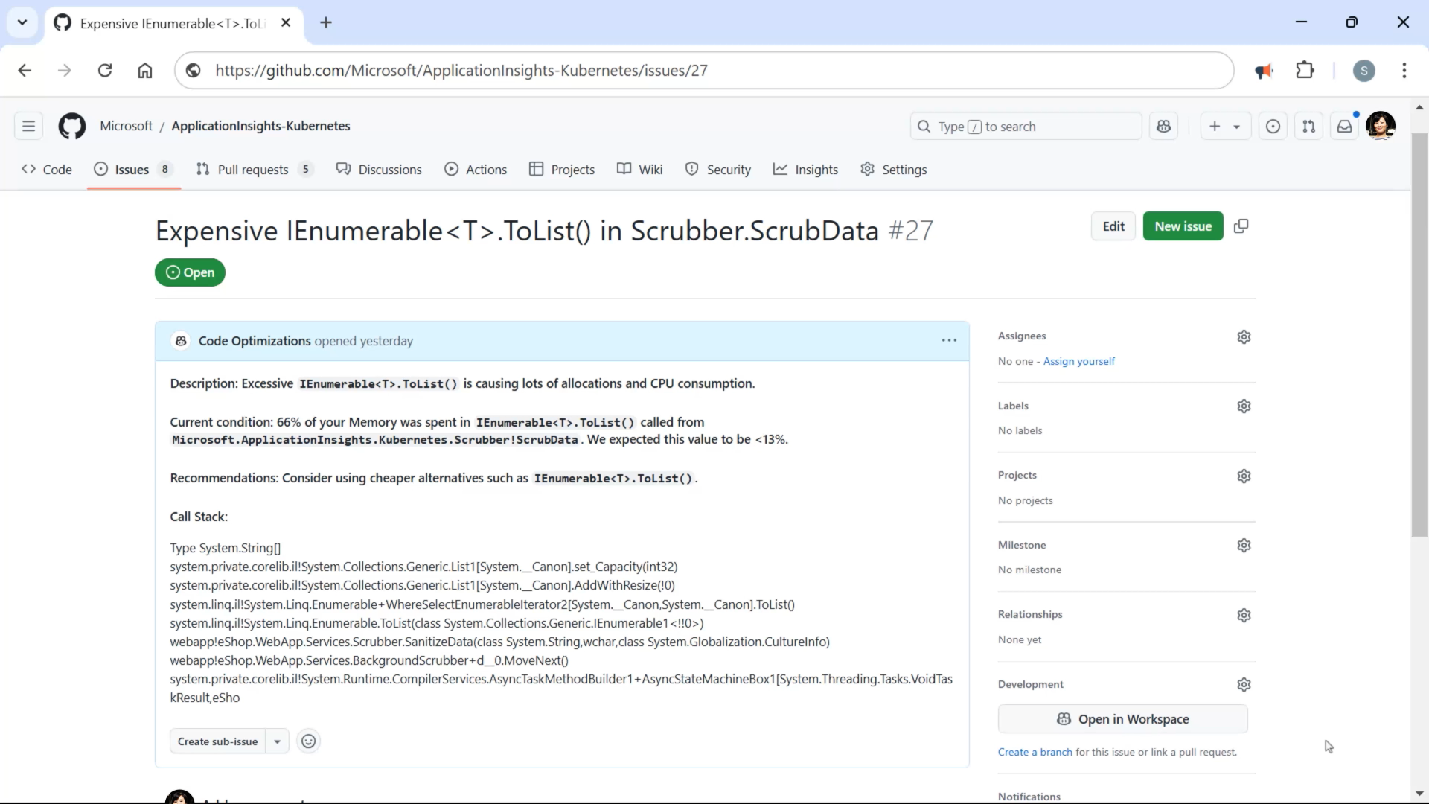

Agentic workflow
Brainstorm
Spec
Plan
Implement
Build & repair
Copilot Workspace
The Agentic IDE
Blog Post: https://github.blog/2024-04-29-github-copilot-workspace Demos: Universe 2024 - How GitHub Next took Copilot Workspace from concept to code, https://youtu.be/L5Xny6yehUg?si=uglP3sIS38bw6IDT & https://www.youtube.com/watch?v=thyJ9LeBfMI
Notes:
Further you can now use copilot in an agentic workflow through copilot workspace.
Anectodotally

Slide 11



Agentic DevOps
AI-powered agents operating as a member of your dev team, automating, optimizing, and accelerating every stage of the software lifecycle.
GitHub Models
GitHub Copilot
SRE Agent
Every developer can be an AI developer with full model accessibility and fine-tuning in GitHub to speed up app development.
Agent Mode
Coding Agent
App Modernization
AI-powered operator, continuously monitoring and optimizing apps in production.
AI-powered pair programmer, performing multi-step tasks at the developer’s command
AI-powered peer programmer, automating routine tasks and jobs to be done across the software lifecycle.
GitHub Copilot extends AI-assisted capabilities to accelerate modernization and upgrades for .NET and Java apps
//Build - Public Preview
Notes:
GA status:
GitHub Models – KTLO
Agent Mode – GA March 2025 (version 1.99)
Coding Agent – GA Copilot coding agent is now generally available - GitHub Changelog
App Mod – GA GitHub Copilot app modernization is now generally available for Java and .NET - GitHub Changelog
SRE Agent – Public Preview, Q2 2025
Indeed, GitHub Copilot serves as the foundation supporting our vision for agentic DevOps, and together with tools like GitHub Models and the Site Reliability Engineering Agent in Azure, we are well on the way to empowering developer teams to adopt agentic DevOps.
During early stages, GitHub Models integrates with GitHub to provide developers with an easy to navigate environment for testing, evaluating, and fine-tuning AI apps and their underlying models, while GitHub Spark provides an AI-native, natural language experience that helps devs prototype by rapidly transforming ideas into deployed apps.
Throughout development, new tools in GitHub Copilot like Agent Mode, Software Engineering Agent, and App modernization agent expand the capabilities available to devs to support multi-step processes throughout development—empowering them to hand off routine tasks around everything from coding, reviewing, and testing, to writing documentation and modernizing their apps—and focus on more high-value, creative work.
And at the far end of the software lifecycle, the Site Reliability Engineering agent in Azure supports engineers deploying, operating, and maintaining applications in production.

Slide 12
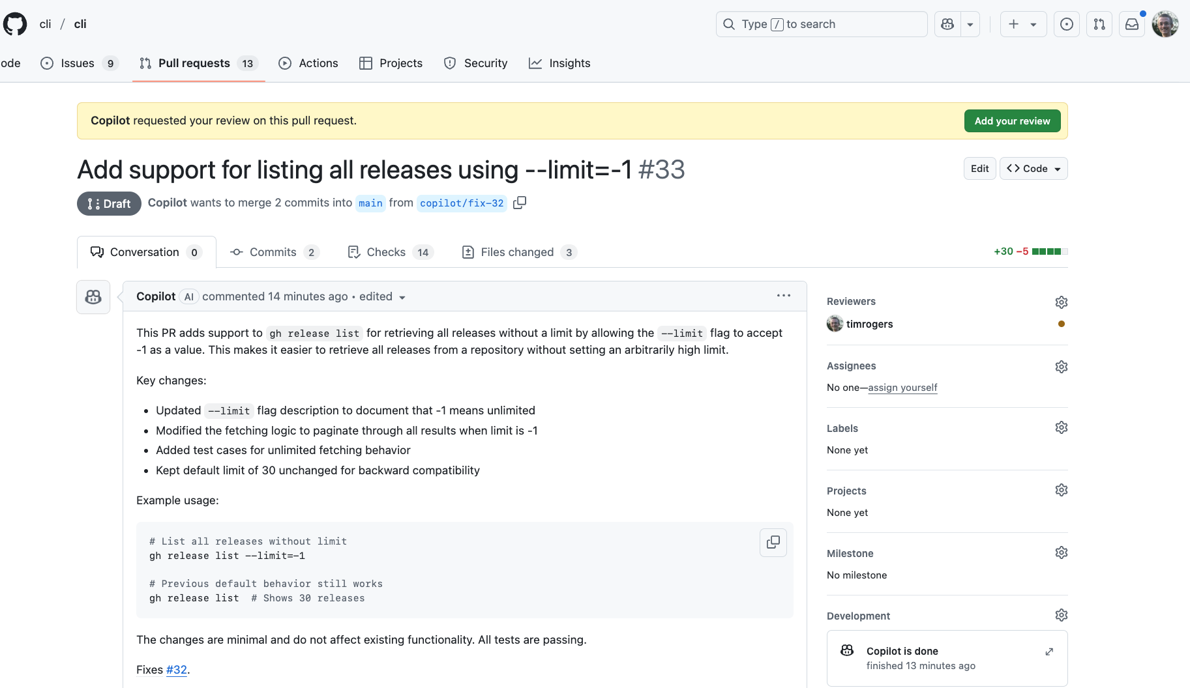
Coding Agent
GitHub Copilot
Agentic capability in GitHub to enhance team productivity like an AI teammate
Assign issues to GitHub Copilot and get back pull requests, automatically validated with tests and linters
Stay in control by working with Copilot just like any other developer and iterating through pull request reviews
Tailor Copilot to your needs by customizing its dev environment, adding custom instructions, and providing external context through MCP servers
Notes:
Developers can now assign GitHub Copilot a range of development tasks from autonomously refactoring code, improving test coverage, and upgrading dependency to fixing defects and implementing new features.
For complex tasks, GitHub Copilot can even collaborate with other agents across all stages of the software lifecycle. Operating as a member of the development team, GitHub Copilot relieves developers of routine tasks to focus developers on more impactful tasks.

Slide 13
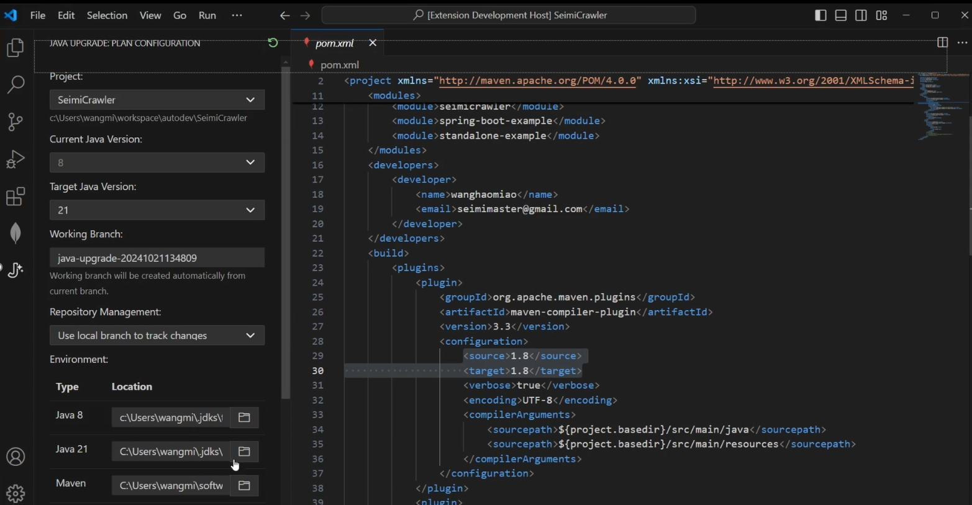
App Modernization
GitHub Copilot
Modernize Java and .NET apps faster than ever with AI agents
Quickly upgrade Java or .NET versions and associated frameworks with AI agents to increase app performance
Perform end-to-end code assessment and remediation for apps to migrate to Azure
Use AI agents to auto remediate code change and bug fixes for moving to Azure app platform services
Stay in control with developer guidance, leverage organizational knowledge/best practices, and validate
Notes:
Developers can now offload complex and time-consuming tasks to rapidly update, upgrade and modernize Java and .NET applications in GitHub Copilot.
App modernization agents intelligently analyze applications, dependencies and issues, understanding legacy applications, programming languages, frameworks and the unique characteristics of your infrastructure to update, transform and modernize applications at scale.
GitHub Copilot now automates code analysis to understand key dependencies and issues, remediating issues to keep existing applications up to date, improving performance and security while reducing license costs.

Slide 14
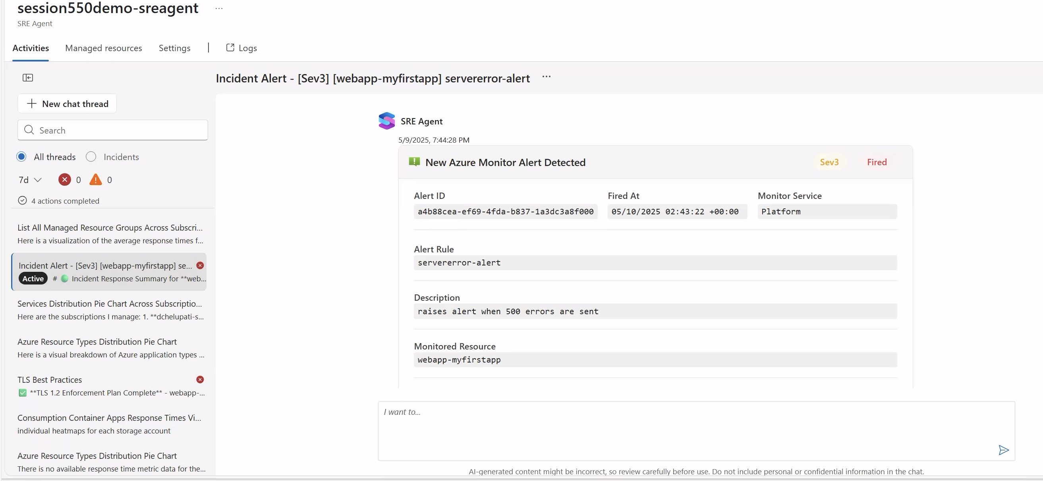
SRE Agent
AI-powered incident management and resource optimization in production
Automatic incident management reduces the number of pager alerts for human SREs
Proactive diagnosis and mitigation to improve application uptime, protecting revenue and reputation
Automated deployments and autonomous rollbacks across large-scale environments help scale your ops without scaling the costs
Continuous monitoring of health and performance of Azure resources, so talent can focus on high-value projects
Notes:
The SRE agent helps cloud developers reduce the cost of operations while improving uptime.
Today, SREs face several challenges, such as, alert fatigue, analyzing root cause quickly, manual workflows, and delivering to the SLA. SRE Agent can offload these tasks and reduce the toil for SREs.
It can automatically respond to production alerts, autonomously mitigate issues, and determine root cause analysis (RCA) bringing resolution time down from hours to minutes. SRE Agent continuously monitors application health and performance for production applications on Azure, including Kubernetes, PaaS, Serverless, and Database services, to build context and provide insights for faster troubleshooting.
Also, by working with SWE agent capabilities in GitHub Copilot, the SRE agent can proactively identify application issues and rapidly drive to resolution with development teams and agent services.
This new service proactively addresses application issues to reduce system downtime, significantly accelerate recovery and autonomously drive resolutions with minimal developer and operator resources.

Slide 15












Maximize GitHub Copilot’s Potential
With the Following Use Cases 🚀 Foundational skills
1
2
3
4
5
Code Completion – Speeds up coding by suggesting entire lines or blocks of code based on context.
Code Refactoring & Optimization
– Improves existing code for better efficiency, readability, and maintainability.
Documentation & Comment Generation
– Automatically generates document files and comments to enhance code clarity.
Test Generation
– Write test cases for code, reducing manual effort in test-driven development.
Bug Fixing & Debugging Assistance
– Helps identify and fix errors quickly with AI-driven suggestions.
Write a Python function that takes a list of numbers and returns the sum of all even numbers.
Refactor this nested loop in for better performance using list comprehensions.
Document this Go function explaining the parameters and return values"
Write unit tests for this JavaScript function using Jest
Fix this c# code that attempts to count the occurrences of a character in a string but is failing
6
7
8
9
10
Code Conversion
– Translate code from one programming language to another.
Infrastructure as Code & Automation
– Help automate infrastructure & CI/CD with YAML, Docker, Terraform, and more.
Copilot in the CLI
– Generate Bash, Git, or GitHub scripts to automate tasks.
SQL Query Optimization
– Assist with writing and improving SQL queries for many DB engines.
Learning & Skill Development
– Acts as a mentor, helping developers understand best practices, existing code or concepts.
Convert this JavaScript function to Python
Write a Kubernetes deployment workflow for a PostgreSQL database.
Shell command to get files over 500mb
Write an SQL query to update the salary of employees in the 'Engineering' department by 10%.
Explain how recursion works in JavaScript and give me an example.
To learn more, check out this free training: aka.ms/GitHubCopilotFundamentals

Slide 16
GitHub Copilot: Use Cases by Persona 👤
Software Developer
Software Tester / QA Engineer
Database Administrator (DBA)
DevOps / IT Ops Engineer
Security Engineer
Code Completion & Suggestion – Autocompletes functions, reducing manual typing.
Boilerplate Generation – Writes repetitive code structures like CRUD operations.
Multi-Language Support – Assists in various programming languages.
Code Refactoring – Suggests improvements for cleaner, more efficient code.
Debugging Assistance – Identifies potential bugs and offers fixes.
API Integration – Generates code for integrating APIs seamlessly.
Unit Test Generation – Writes test cases automatically.
Documentation Assistance – Generates comments and documentation.
Automated Test Case Generation Creates unit and integration tests.
Edge Case Suggestions – Identifies untested scenarios.
Test Data Generation – Produces realistic test data.
Bug Reproduction Assistance – Helps replicate issues with generated test scripts.
Mock Data & Stubbing – Automates mock object creation.
Regression Test Writing – Suggests regression tests based on code changes.
Code Coverage Improvement – Highlights untested areas of code.
Automation Scripting – Generates Selenium, Cypress, or Playwright test scripts.
SQL Query Optimization – Suggests more efficient queries.
Schema Design Assistance – Helps create optimal table structures.
Stored Procedure Generation – Automates stored procedure writing.
Indexing Recommendations – Suggests indexes for performance improvement.
Data Migration Assistance – Generates scripts for moving data efficiently.
Backup & Recovery Scripting – Automates backup and restore scripts.
Query Debugging & Error Fixing – Identifies syntax errors and suggests corrections.
Data Analysis Queries – Generates complex analytical SQL queries.
Infrastructure as Code (IaC) – Generates Terraform, Bicep, or CloudFormation scripts.
CI/CD Pipeline Automation – Suggests YAML configurations for GitHub Actions or pipelines.
Log Parsing & Analysis – Assists in writing log analysis scripts.
Containerization & Orchestration – Generates Dockerfiles and Kubernetes manifests.
System Monitoring – Automates creation of monitoring scripts.
Incident Response Automation – Assists in automating system recovery actions.
Network & Security Configuration – Suggests secure configurations for cloud services.
Shell Scripting – Writes Bash and PowerShell scripts for automation.
Secure Coding Suggestions – Identifies and mitigates security vulnerabilities.
Threat Modeling Assistance – Helps define security risks in code.
Security Policy Enforcement – Generates security compliance scripts.
Automated Penetration Testing – Assists in writing security testing scripts.
Log Analysis for Threat Detection – Automates log parsing for security insights.
IAM & Access Control Configuration – Generates secure IAM policies.
Encryption & Hashing Guidance – Suggests best practices for cryptographic implementations.
Key Benefits of GitHub Copilot for All Roles
✅ Accelerates workflows
✅ Reduces cognitive load
✅ Enhances learning
✅ Improves efficiency
Reduces coding time by generating suggestions, boilerplate code, and automation scripts.
Minimizes the need to remember syntax, allowing engineers to focus on problem-solving.
Provides real-time examples, helping users learn new languages, frameworks, and best practices.
Reduces context-switching and manual effort, enabling faster development cycles.

Slide 17
GitHub Copilot: Use Cases by Persona 👤
Project Manager
Data Scientist
Data Scientist cont.
Automated Project Planning – Generate project plans, milestones, and Gantt charts using natural language prompts.
Effort Estimation – Use Copilot to assist in high-level effort estimation and resource planning.
Sprint Planning & Backlog Refinement - Draft sprint plans, refine backlogs, and prioritize tasks with AI support.
User Story & Acceptance Criteria Generation – Automatically create user stories and acceptance criteria from feature descriptions.
Risk Identification & Mitigation – Identify potential risks and suggest mitigation strategies based on historical data.
Change Request Estimation – Quickly estimate the impact and effort of change requests.
Data Cleaning Automation – Use Copilot to write scripts for handling missing values, outliers, and data normalization.
Exploratory Data Analysis (EDA) – Generate code for visualizations, statistical summaries, and correlation analysis.
Model Prototyping – Rapidly scaffold machine learning models usinglike scikit-learn, XGBoost, or PyTorch.
Feature Engineering – Suggest and implement feature transformations and selection techniques.
Pipeline Automation – Build reusable data pipelines for preprocessing, training, and evaluation.
Experiment Tracking – Integrate with tools like MLflow to log metrics and compare model runs.
Documentation & Reporting – Auto-generate markdown reports and Jupyter notebook annotations.
Deployment Readiness – Assist in containerizing models and writing deployment scripts for cloud platforms.
Quota, Cost & Content Safety Management -Automate scripts to manage LLM usage quotas, cost tracking, and content filtering policies across environments.
Key Benefits of GitHub Copilot for All Roles
✅ Accelerates workflows
✅ Reduces cognitive load
✅ Enhances learning
✅ Improves efficiency
Reduces coding time by generating suggestions, boilerplate code, and automation scripts.
Minimizes the need to remember syntax, allowing engineers to focus on problem-solving.
Provides real-time examples, helping users learn new languages, frameworks, and best practices.
Reduces context-switching and manual effort, enabling faster development cycles.

Slide 18
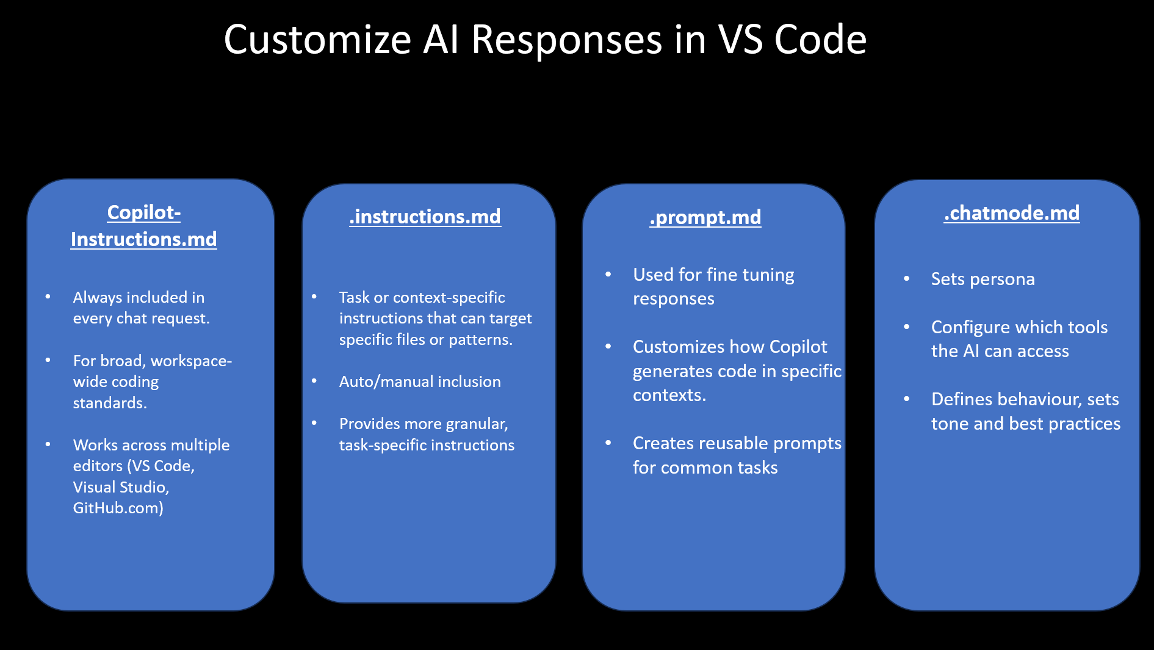
GHCP Primitives

